Slide 1
Window Programming 2-1
Events
Yuan Ze University

Slide 2
Event-driven in Visual C# .NET
Object
  form1, button1
Event
  Load, Click, MouseDown
Event function
  form1_Load

Slide 3
Event-driven in Visual C# .NET
Add Objects
Set up events
  Event attribute of objects
Set up event functions

Slide 4
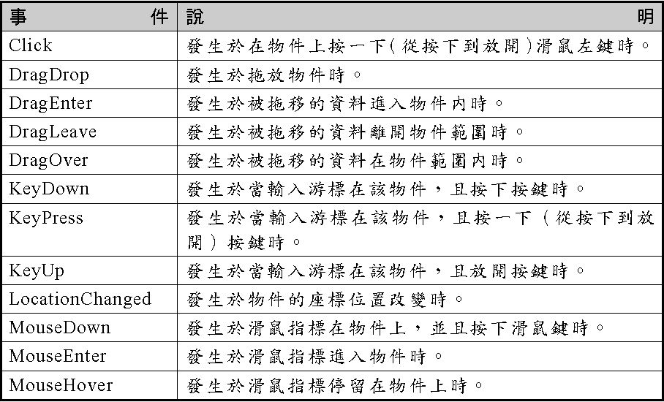
Events

Slide 5
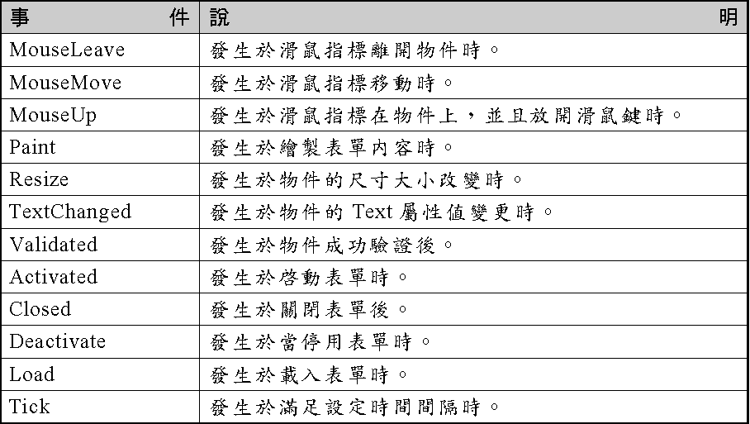
Events

Slide 6
Form Events
Load & Activated

Slide 7
Common event function of Form object
Event function name=object name + Event
Load
  Called when first time to load form
  Event function: Form1_load
  Initialization

Slide 8
Common event function of Form object
Activated
  Called when the Form is activated
    After the Form is load
    Click the Form when the Form is un-activated
    When a minimized Form return to original size

Slide 9
Common event function of Form object
Click
  Click the left button of the mouse on the Form (or other object)

Slide 10
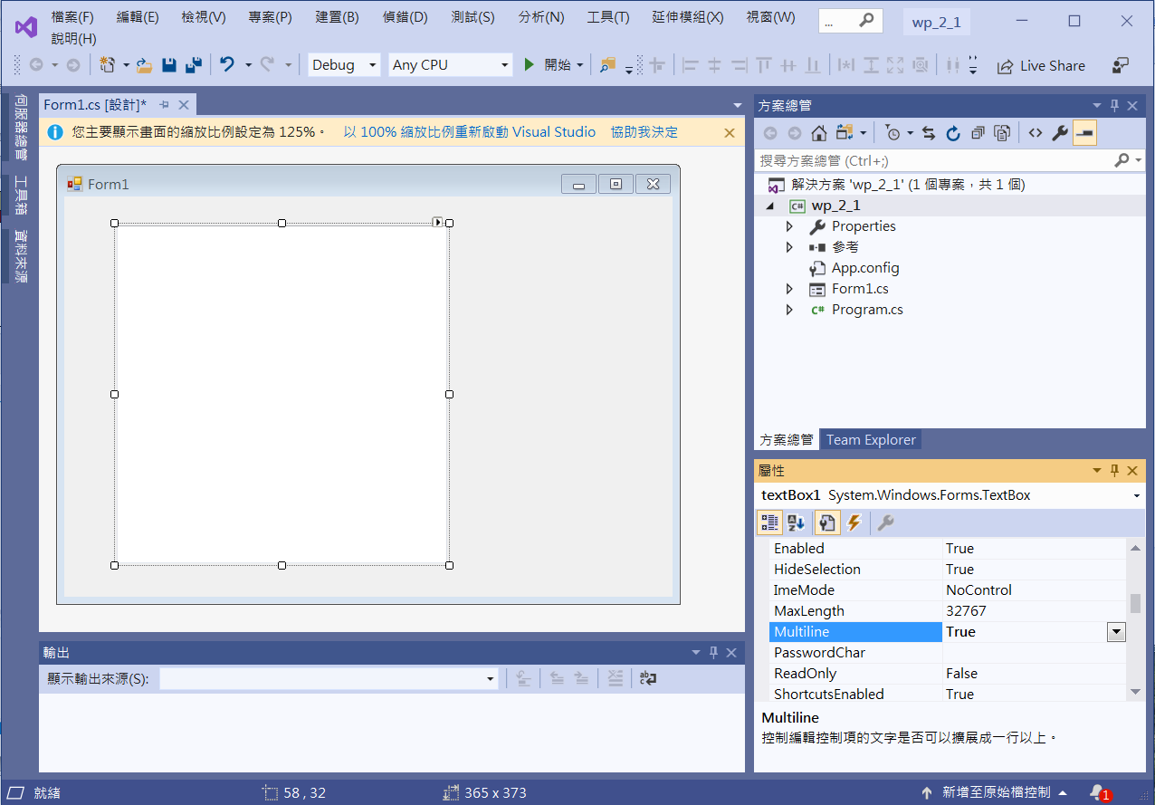
Edit interface
testBox1
Set Multiline True
so that the textBox1 can be dragged to have multiline

Slide 11
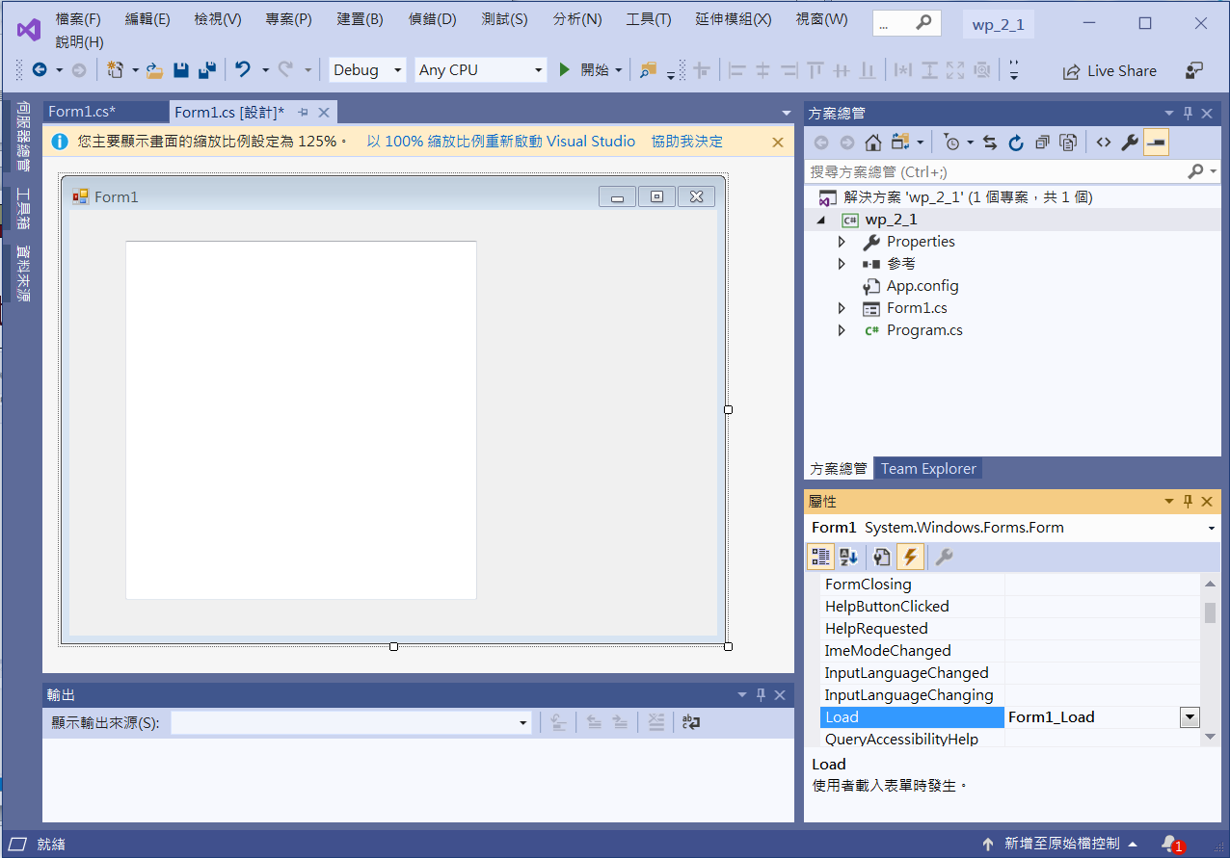
Add event functions
Click at Form1
Click at Events
Double Click at Load
to generate event function

Slide 12
Add event functions
private void Form1_Load(object sender, EventArgs e)
{
textBox1.Text = "Form1 Load事件\n";
}
private void Form1_Activated(object sender, EventArgs e)
{
textBox1.AppendText("Form1 Activated事件\n");
}

Slide 13
Add event functions
private void Form1_Click(object sender, EventArgs e)
{
textBox1.AppendText("Form1 Click事件\n");
}
private void textBox1_Click(object sender, EventArgs e)
{
textBox1.AppendText("textBox1 Click事件\n");
}

Slide 14
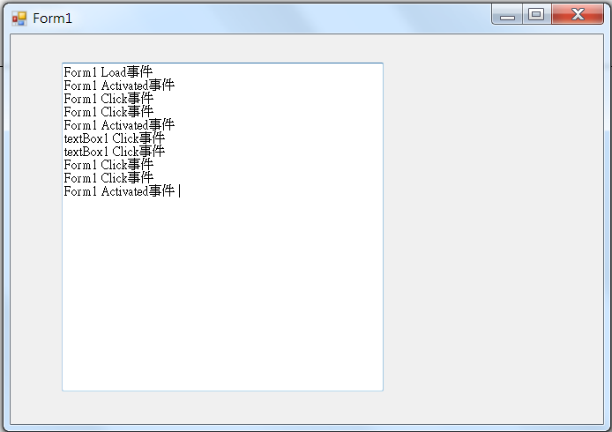
Exercise#2-1

Slide 15
內容來源
  Visual C# 2013視窗程式設計(黃聰明/著; 松崗)
  跟著範例學會Visual C# 2015(張逸中/著; 博碩)

